Slide 1
COMP408 Term Project
Anomaly Detection in Crowded Scenes
Arda Kırkağaç 49799
Gökberk Özsoy 49721

Slide 2
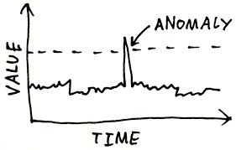
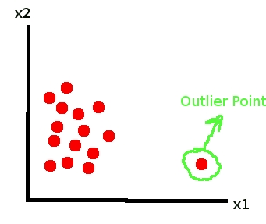
What is anomaly?
Anomaly (outlier) is an item, event, or an observation which do not conform to an expected pattern or other items in a dataset.

Slide 3
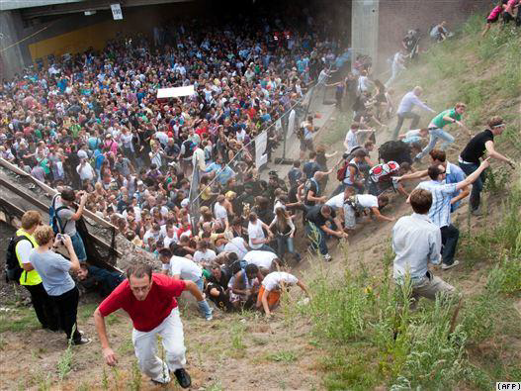
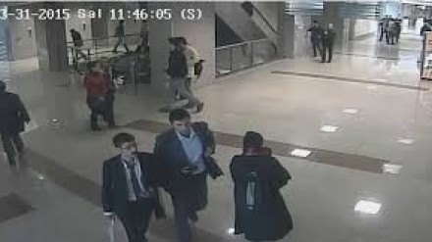
Anomaly in Our Context
Anomaly detection in crowd scenes is very important because of more concern with people safety in public place.

Slide 4
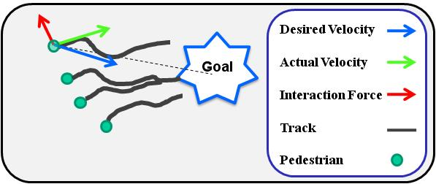
Literature Review - Example

Slide 5
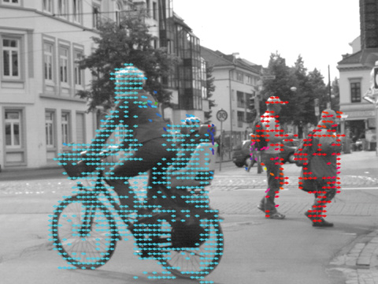
Our Method
Optical flow or optic flow is the pattern of apparent motion of objects, surfaces, and edges in a visual scene caused by the relative motion between an observer and a scene.

Slide 6
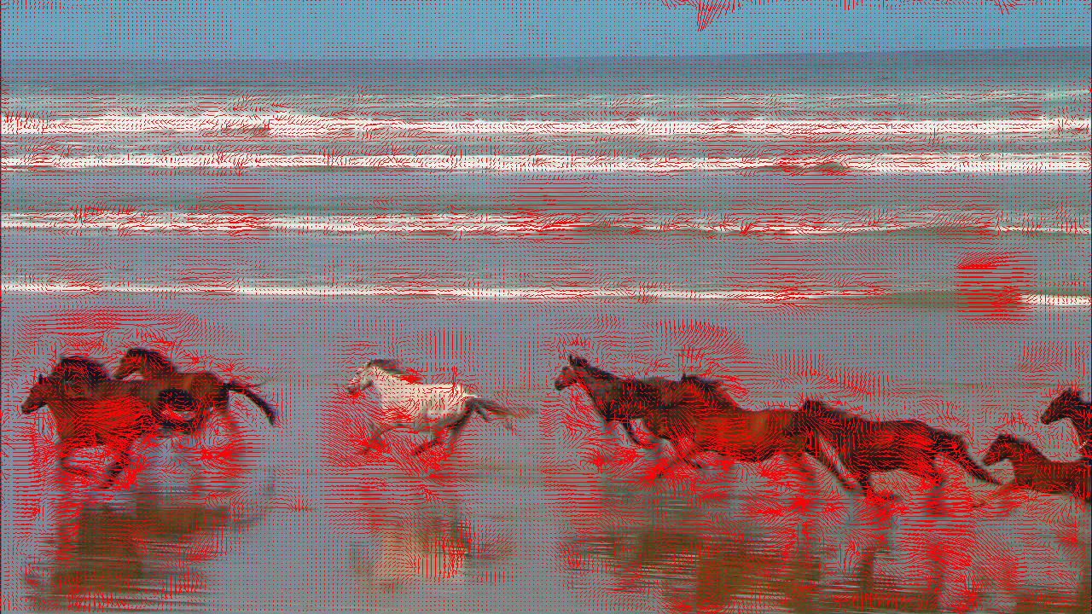
Our Method

Slide 7
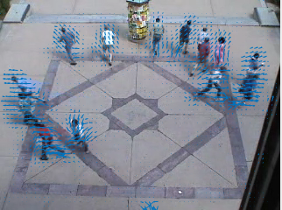
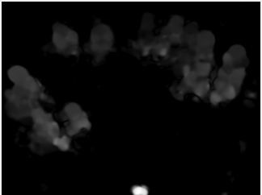
Output of Farneback’s Optical Flow Algorithm

Slide 8
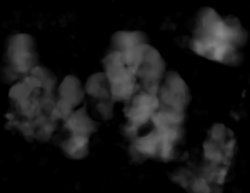
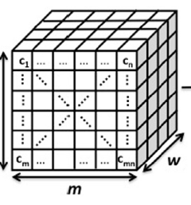
Activity Map
To see temporal variation
Temporal (three-dimensional) window of length 30, which is equivalent to 1 second for a video of 30 fps.

Slide 9
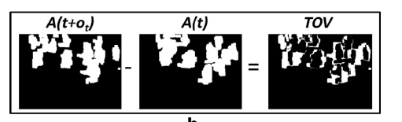
Metrics - Temporal Occupancy Variation

Slide 10
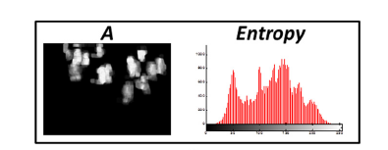
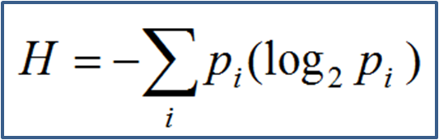
Metrics - Image Entropy

Slide 11
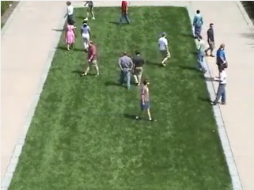
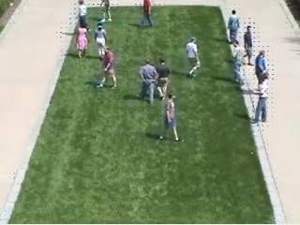
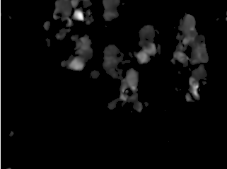
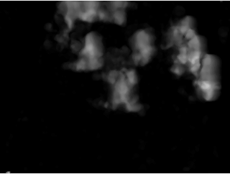

Normal scene from sample video sequence

Slide 12
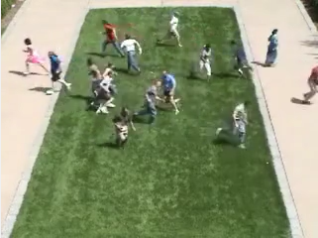
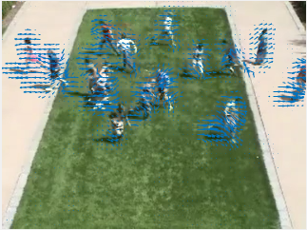
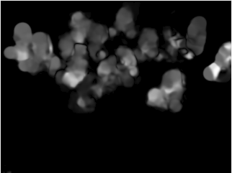
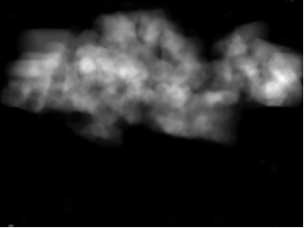
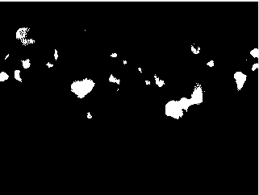
Abnormal scene from sample video sequence

Slide 13
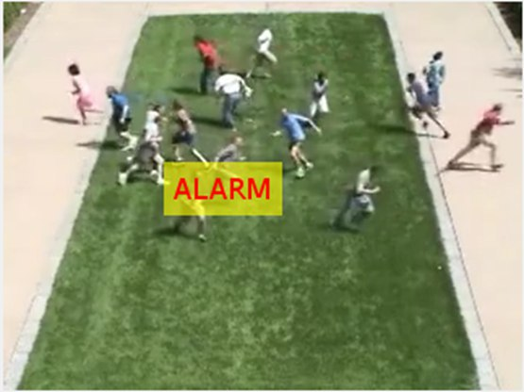
Sample output

Slide 14
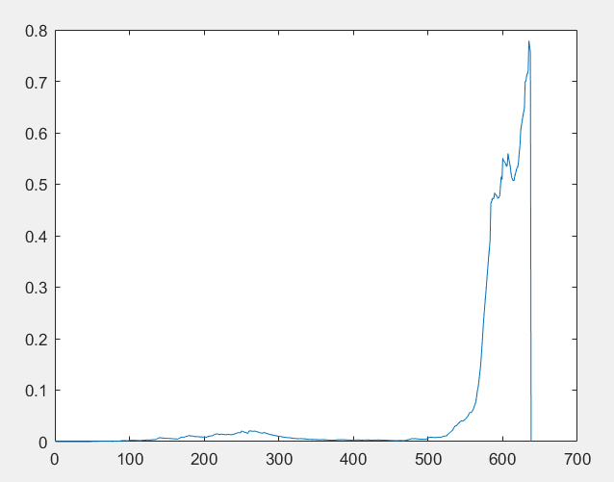
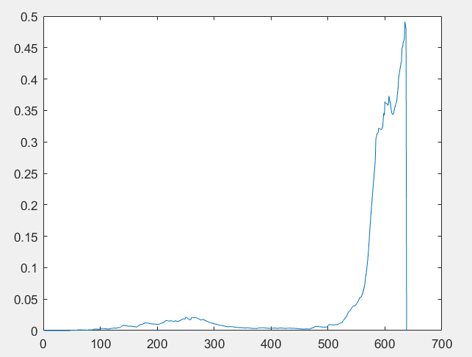
Results - Plot for TOV and Entropy
Entropy
TOV
Image Frame Numbers
Image Frame Numbers

Slide 15
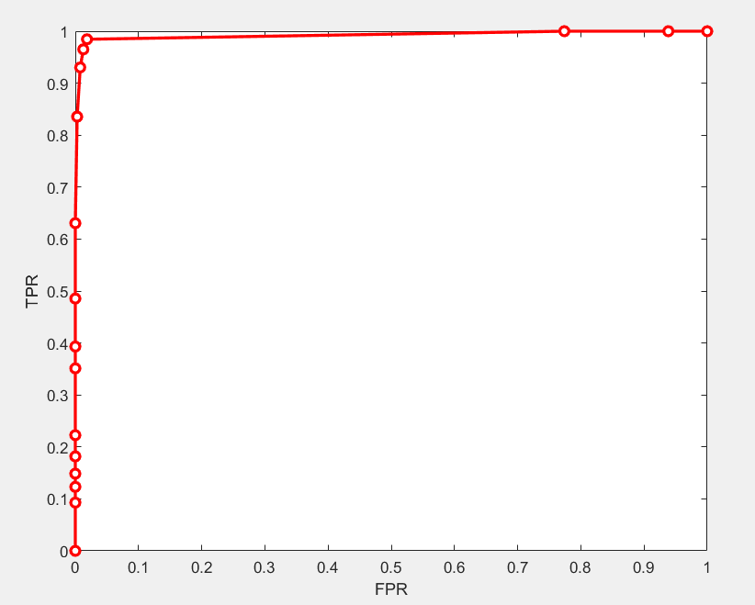
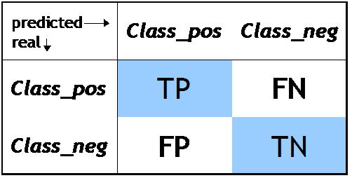
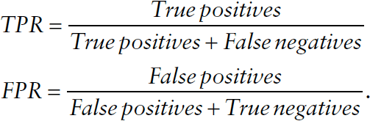
ROC PLOT

Slide 16
Now, let’s have a demo
Then, get Questions and Comments
Thank you for listening!

